Slide 1
Decision Tree Learning
ID3 and C4.5 Algorithms

Slide 2
Iterative Dichotomiser 3 (ID3) Algorithm

Slide 3
Outline
Basics of Decision Tree
Introduction to ID3
Entropy and Information Gain
Examples

Slide 4
Decision Tree Learning
For Discrete valued functions that is robust to noisy data and capable of learning disjunctive expressions.
Their inductive bias is a preference for small trees over large trees
  The inductive bias (also known as learning bias) of a learning algorithm is the set of assumptions that the learner uses to predict outputs given inputs that it has not encountered.

Slide 5
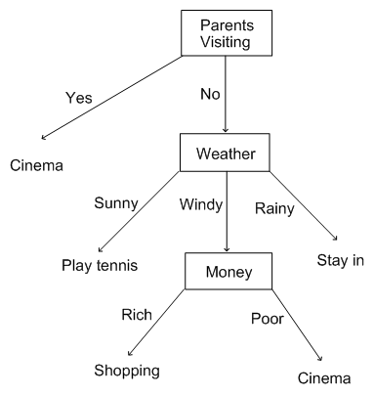
Basics
Decision node: Specifies a test of some attribute
What is a decision tree?
A tree where each branching (decision) node represents a choice between 2 or more alternatives, with every branching node being part of a path to a leaf node
Leaf node: Indicates classification of an example

Slide 6
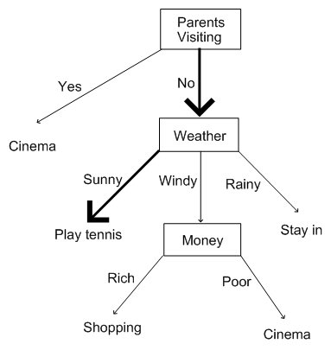
Decision Tree enables us to take decisions
Based on list of attributes evaluating to one classification class
If the parents are visiting, then go to the cinema
or
If the parents are not visiting and it is sunny, then play tennis
or
If the parents are not visiting and it is windy and you're rich, then go shopping
or
If the parents are not visiting and it is windy and you're poor, then go to cinema
or
If the parents are not visiting and it is rainy, then stay in.

Slide 7
Decision Tree- looks like a mental decision
However we will be programming an agent to learn decision trees from example
Decision trees don't have to be representations of decision making processes, and they can equally apply to categorisation problems.

Slide 8
Invented by J. Ross Quinlan
Employs a top-down greedy search through the space of possible decision trees.
Greedy because there is no backtracking. It picks highest values first.
Select attribute that is most useful for classifying examples
i.e. Attribute that has the highest Information Gain

Slide 9

Entropy
Tom Mitchel: Entropy measures the impurity of an arbitrary collection of examples.
Minimum number of bits of information needed to encode the classification of an arbitrary member of Collection S.
For a collection S, entropy is given as:
Binary Decision Problem: For a collection S having positive and negative examples, entropy is given by
Entropy(S) = - p₊ log₂p₊ - p₋ log₂p_{- where,}
p₊ is the proportion of positive examples
p₋ is the proportion of negative examples
Entropy(S) = 0 if all members of S belong to the same class.
Entropy(S) = 1 (maximum) when all members are split equally.
Where, p_{i} is the proportion of
S belonging to class i.

Slide 10
Example :
Suppose S is a collection of 14 examples of some Boolean concept, including 9 positive and 5 negative examples
  [9+ , 5-]
Entropy (s) = ??

Slide 11
Example
Suppose S is a collection of 14 examples of some bollean concept, including 9 positive and 5 negative examples
  [9+ , 5-]
Entropy (s) = ??
Entropy ([9+ , 5-]) = - (9/14) log₂ (9/14) – (5/14) log₂ (5/14)
= 0.940

Slide 12
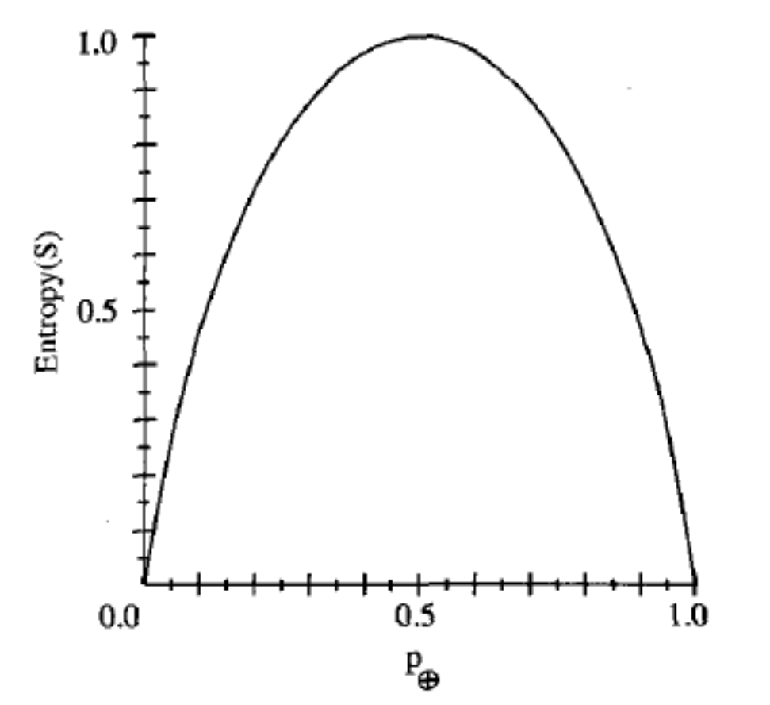
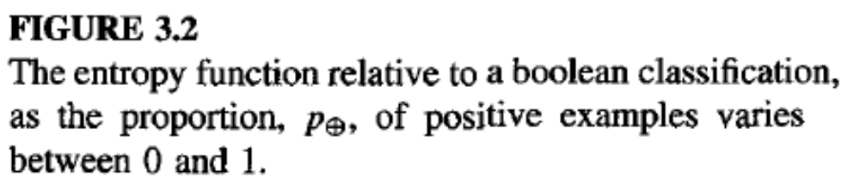

Slide 13
Self Information:
i(A)= - log_{b} P(A)
Average Self information associated with the random experiment is given by
Entropy = ∑ P(Ai) i(Ai)

Slide 14
Expected reduction in entropy
caused by partioning the
examples according to this
attribute.
INFORMATION GAIN
Entropy of original collection S
Expected value of the entropy after S is partitioned using Attribute A
Number of bits saved when encoding the target value of an arbitrary member of S, by knowing the value of the Attribute A

Slide 15

Information Gain(IG)
Measures the expected reduction in entropy.
The higher the IG, more is the expected reduction in entropy.
Where,
S: is the sample set or training set
Values A: is the set of all possible values for attribute A
S_{v} : is the subset of S for which attribute A has value v
i.e. S_{v} = {s ϵ S | A(s) = v}

Slide 16
Decision Tree Algorithms are best suited to problems with the following characteristics
Instances are better represented by attribute value pairs
The target function has discrete output values
Disjunctive descriptions may be required
The training data may contain errors
The training data may contain missing attribute values

Slide 17
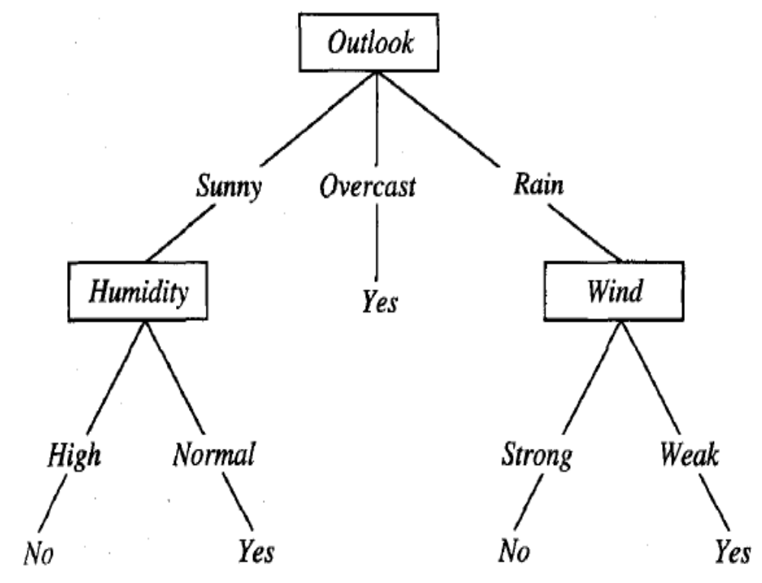
Decision Tree for the concept : PlayTennis

Slide 18
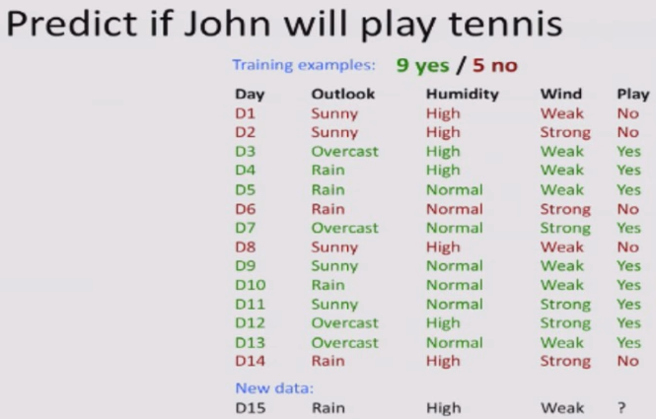
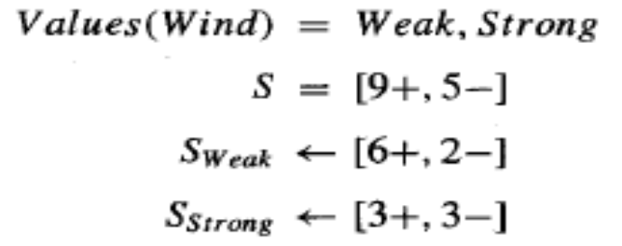
Example 1
Assume S is a collection containing 14 examples, [9+, 5-].
Of these examples, suppose 6 of the positive and 2 of the negative examples have
Wind = Weak, and the remainder have Wind = Strong

Slide 19
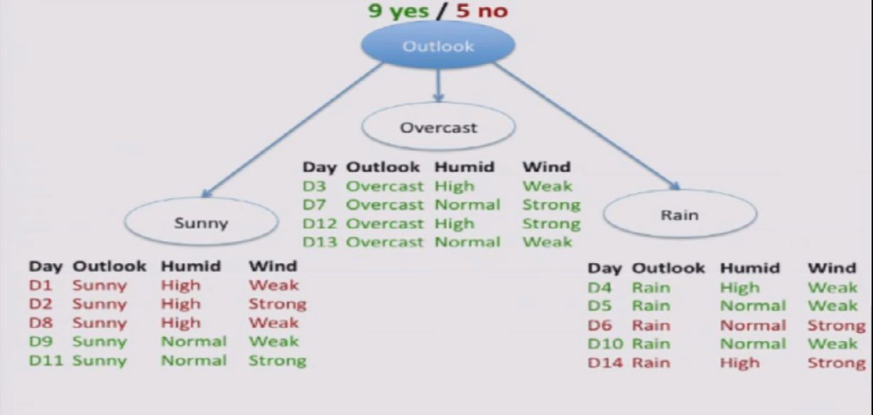

Slide 20
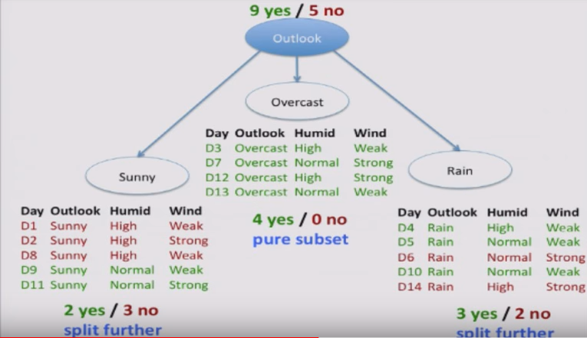

Slide 21
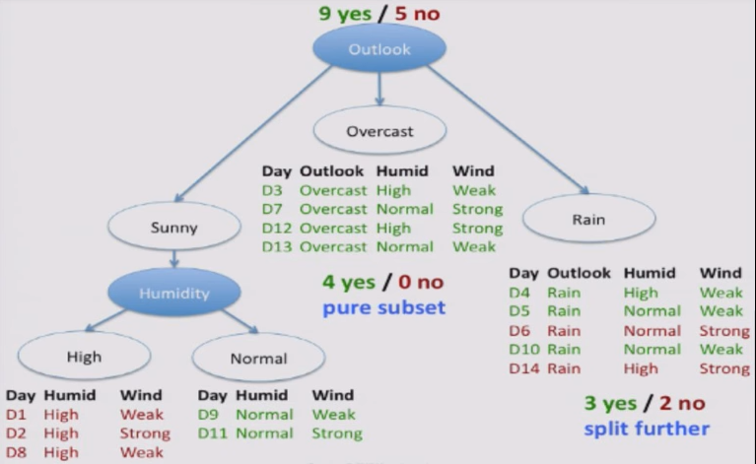

Slide 22
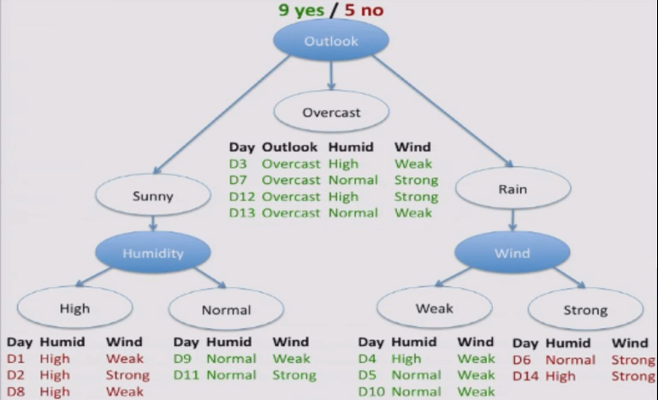

Slide 23
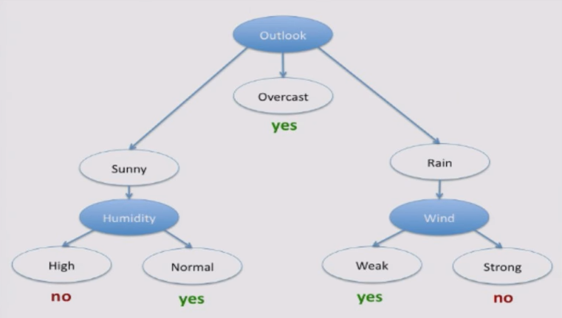
Decision Tree: Logical formula that tells you in what cases john will play and in what cases john doesn’t play

Slide 24
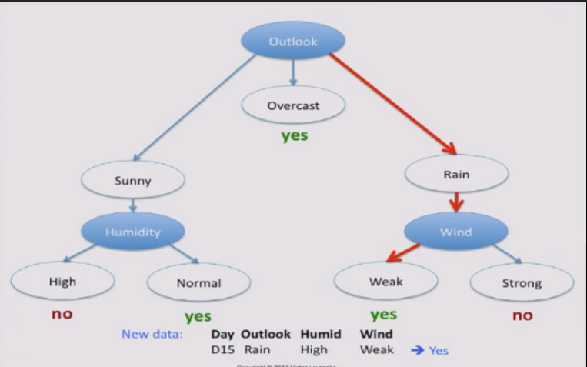

Slide 25
ID3
Given a set of examples, S, categorised in categories c_{i}, then:
Choose the root node to be the attribute, A, which scores the highest for information gain relative to S.
For each value v that A can possibly take, draw a branch from the node.
For each branch from A corresponding to value v, calculate S_{v}.
Then
If S_{v} contains only examples from a category c, then put c as the leaf node category which ends that branch.
Else ??
4. The algorithm terminates either when all the attributes have been exhausted, or the decision tree perfectly classifies the examples.

Slide 26
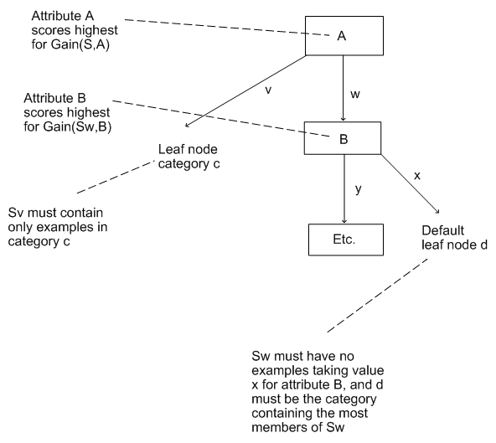
ID3

Slide 27
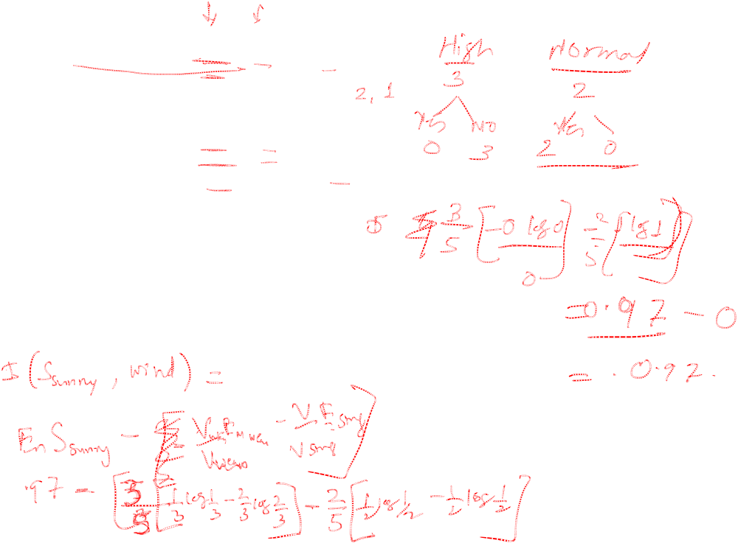
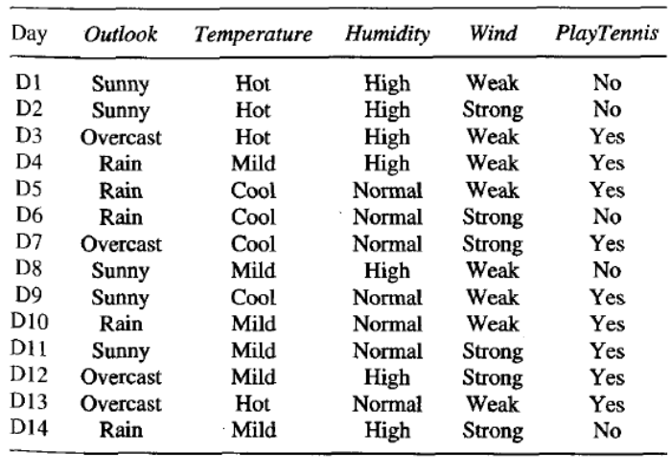

Example: Learning to construct the Tree computationally

Slide 28
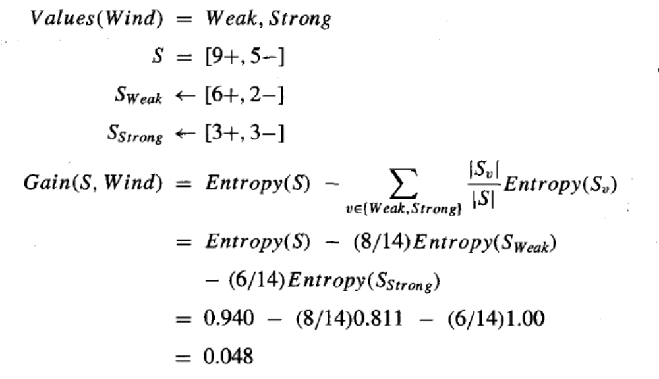
For attribute ‘Wind’
Likewise for all other attributes, temperature, outlook, humidity

Slide 29
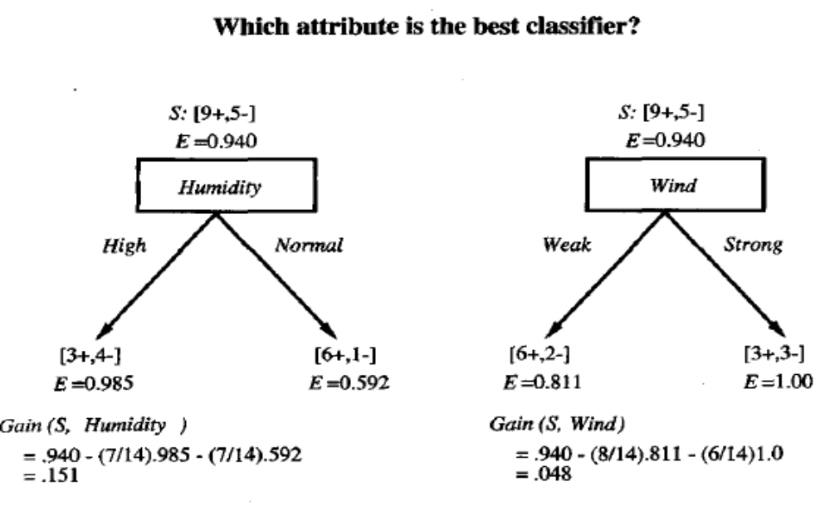
Values of Humidity -> High and Normal
Here for S = [9+, 5-] Shigh = [ 3+, 4-] Snormal = [6+, 1-]
Information gain by this partitioning = 0.151 compared to 0.048 for the attribute Wind
Humidity provides greater information gain than Wind

Slide 30
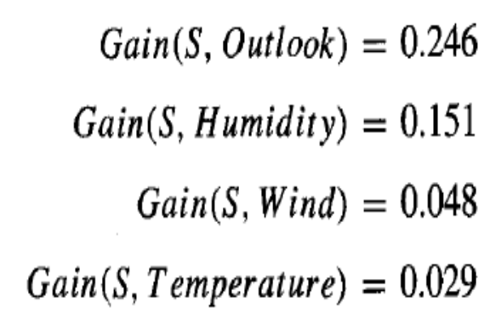
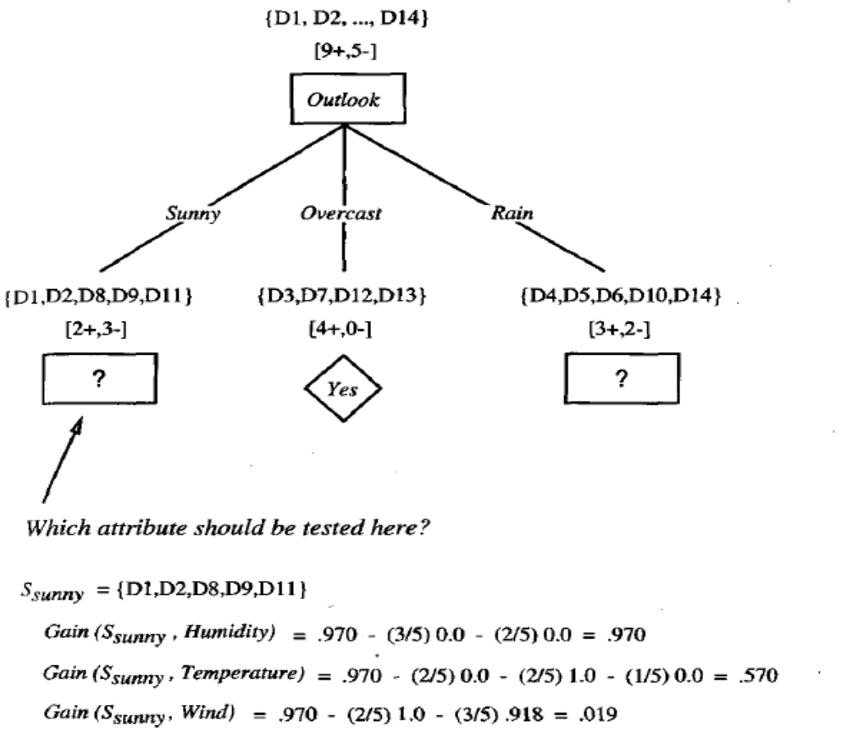
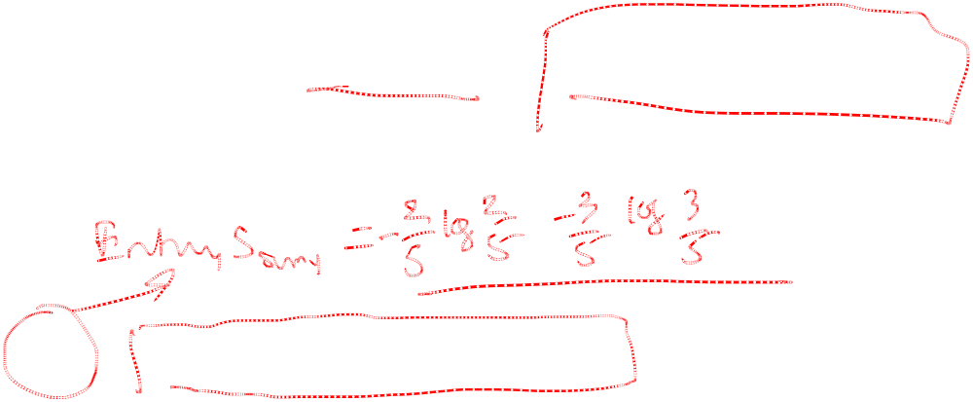
Overcast descendent
become a leaf node -> ???

Slide 31
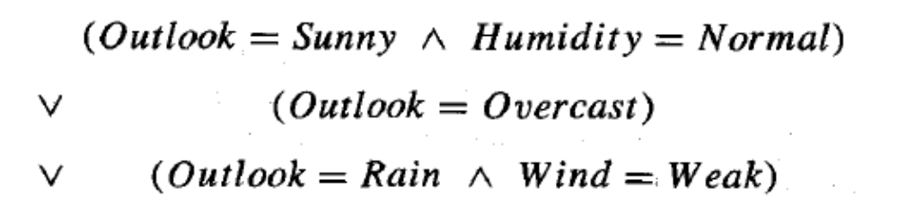

Slide 32
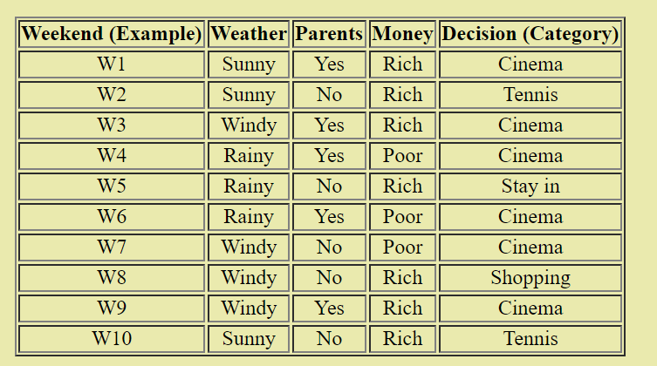

Slide 33
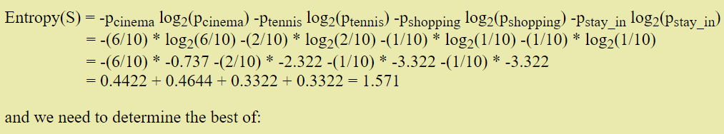
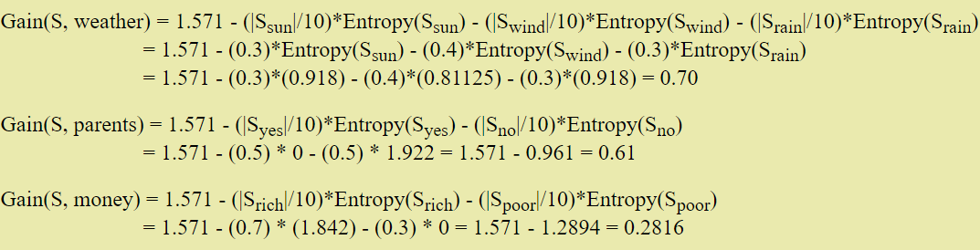
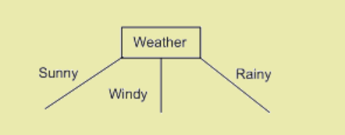

Slide 34
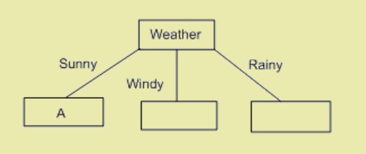
Now we look at the first branch. S_{sunny} = {W1, W2, W10}. This is not empty, so we do not put a default categorisation leaf node here.
The categorisations of W1, W2 and W10 are Cinema, Tennis and Tennis respectively.
Looking at the second branch, S_{windy} = {W3, W7, W8, W9}
Likewise for Srainy

Slide 35
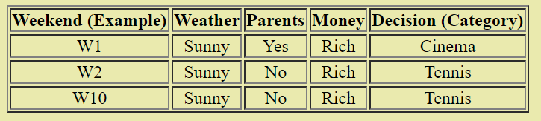
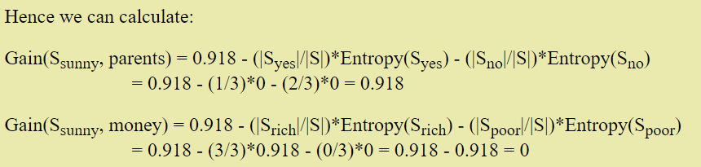
Notice that Entropy(S_{yes}) and Entropy(S_{no}) were both zero, because
S_{yes} contains examples which are all in the same category (cinema), and
S_{no} contains examples which are all in the same category (tennis).
This should make it more obvious why we use information gain to choose attributes to put in nodes.

Slide 36
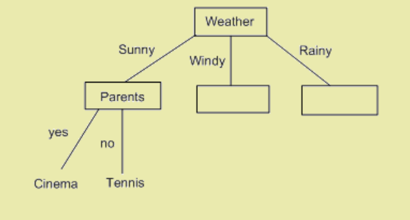
So attribute A should be taken as parents.
The two values from parents are yes and no, and we will draw a branch from the node for each of these.
Remembering that we replaced the set S by the set S_{Sunny}, looking at S_{yes}, we see that the only example of this is W1. Hence, the branch for yes stops at a categorisation leaf, with the category being Cinema.
Also, S_{no} contains W2 and W10, but these are in the same category (Tennis). Hence the branch for no ends here at a categorisation leaf.

Slide 37
Hypothesis Space Search in Decision Tree Learning
ID3 can be characterized as Searching space of hypothesis for one that fits the training examples
Hypothesis space : searched by ID3 is the possible decision trees
Uses Hill climbing search:
  Starting with a empty tree, then considering progressively more elaborate hypothesis in search of a decision tree that correctly classifies the training data
  Evaluation function guiding hill climbing is the Information Gain

Slide 38
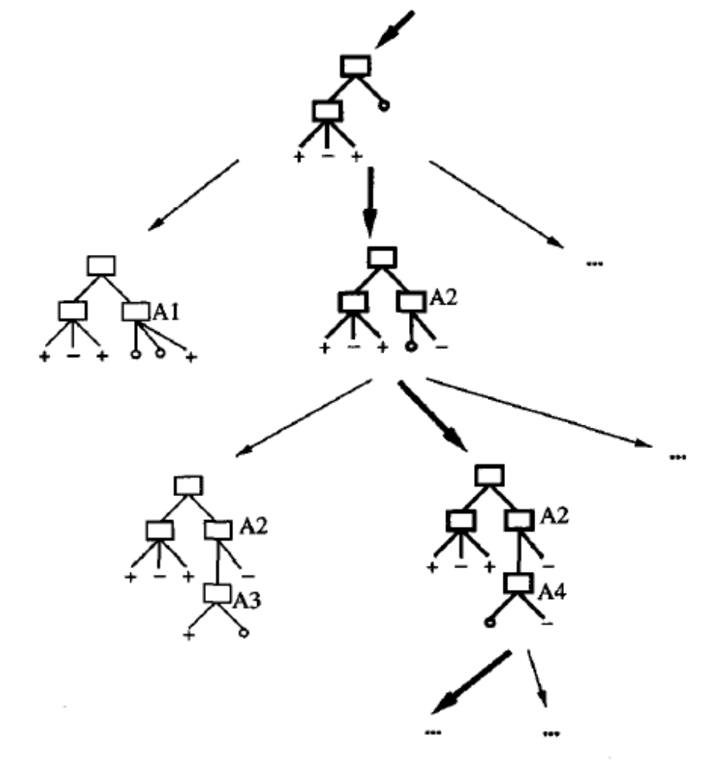
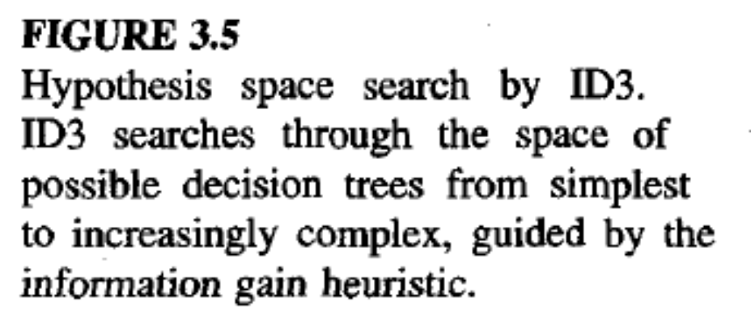

Slide 39
Hypothesis Space Search in Decision Tree Learning
ID3 hypothesis space of all decision trees is a complete space of finite discrete valued functions…no risk of searching incomplete spaces
Maintains only a single current hypothesis as it searches through the space of decision trees
ID3 in its pure form performs no backtracking in its search
ID3 uses all the training examples at each step in the search to make statistically based decisions regarding how to refine its current hypothesis

Slide 40
Inductive Bias in Decision Tree Learning
Which of the decision tree does ID3 choose ????
Approximate inductive Bias : Shorter trees are preferred over higher trees
A closer approximation to the inductive bias of ID3 : Shorter trees are preferred over longer trees. Trees that place higher information gain attributes close to the root are preferred over those that do not.
ID3 uses Information gain Heuristic and Hill Climbing strategy

Slide 41
Hill climbing is a mathematical optimization technique which belongs to the family of local search.
It is an iterative algorithm that starts with an arbitrary solution to a problem, then attempts to find a better solution by incrementally changing a single element of the solution. If the change produces a better solution, an incremental change is made to the new solution, repeating until no further improvements can be found.

Slide 42
Types: Restrictions and Preference Bias
ID3 searches a complete hypothesis space but does so incompletely since once it finds a good hypothesis it stops (cannot find others).
Candidate-Elimination searches an incomplete hypothesis space (it can only represent some hypothesis) but does so completely.
A preference bias is an inductive bias where some hypothesis are preferred over others.
A restriction bias is an inductive bias where the set of hypothesis considered is restricted to a smaller set.

Slide 43
Occam’s Razor
William Occam : Occam's razor: Prefer the simplest hypothesis that fits the data.
Why should we prefer a shorter hypothesis?
  Prefer 5 node hypothesis over 500 nodes hypothesis
There are fewer short hypothesis than long hypothesis so
  a short hypothesis that fits data unlikely to be coincidence
  a long hypothesis that fits data might be coincidence.
But, there are many ways to define small sets of hypothesis
  e.g., all trees with a prime number of nodes that use attributes beginning with Z.

Slide 44
Issues in Decision Tree Learning
How deep to grow?
How to handle continuous attributes?
How to choose an appropriate attributes selection measure?
How to handle data with missing attributes values?
How to handle attributes with different costs?
How to improve computational efficiency?
ID3 has been extended to handle most of these. The resulting system is C4.5.

Slide 45
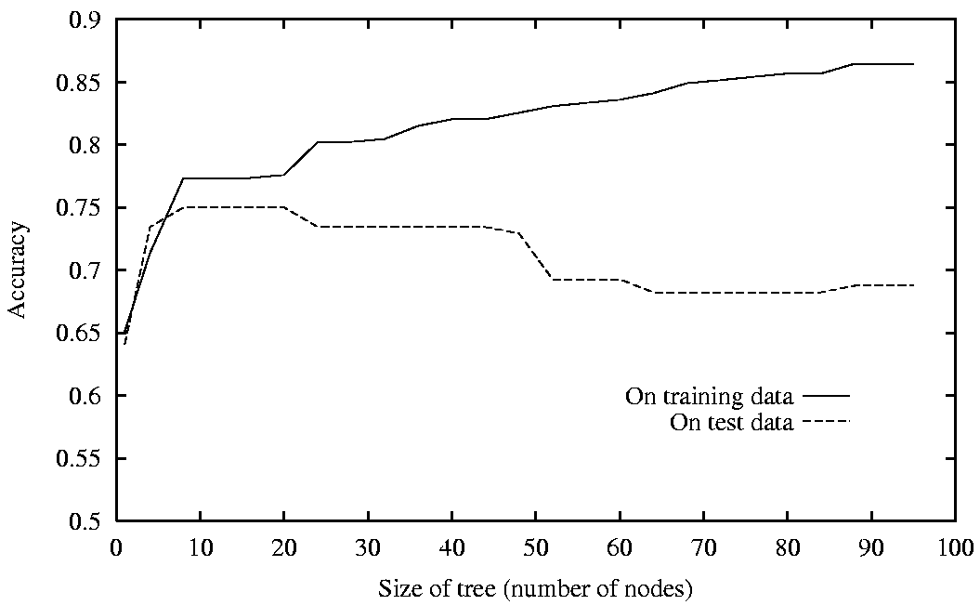
Overfitting (noise in data, training example is too small)
If there are errors in the training data.
It becomes worse if we let the tree grow to be too big, as shown in this experiment:

Slide 46
Dealing with overfitting
Either stop growing the tree earlier or prune it after-wards. Pruning has been more effective.
Use a separate set of examples (not training) to evaluate the utility of post-pruning nodes.
Use a statistical test to estimate whether expanding a node is likely to improve performance beyond the training set.
Use explicit measure of the complexity for encoding the training examples and the decision tree. Stop when this encoding size is minimize. Minimum Description Length principle (later).

Slide 47
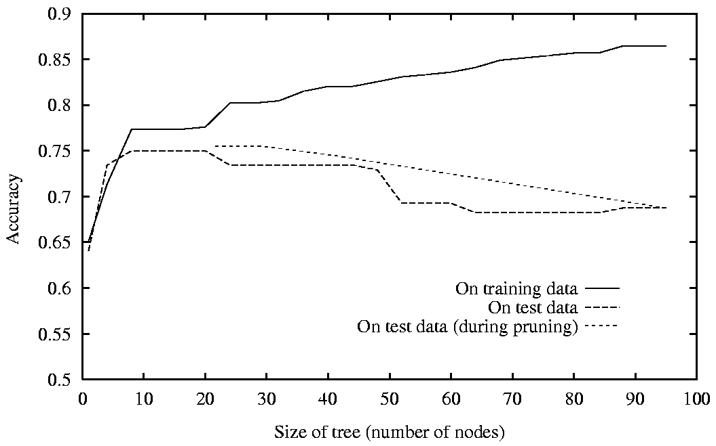
Reduced Error Pruning

Slide 48
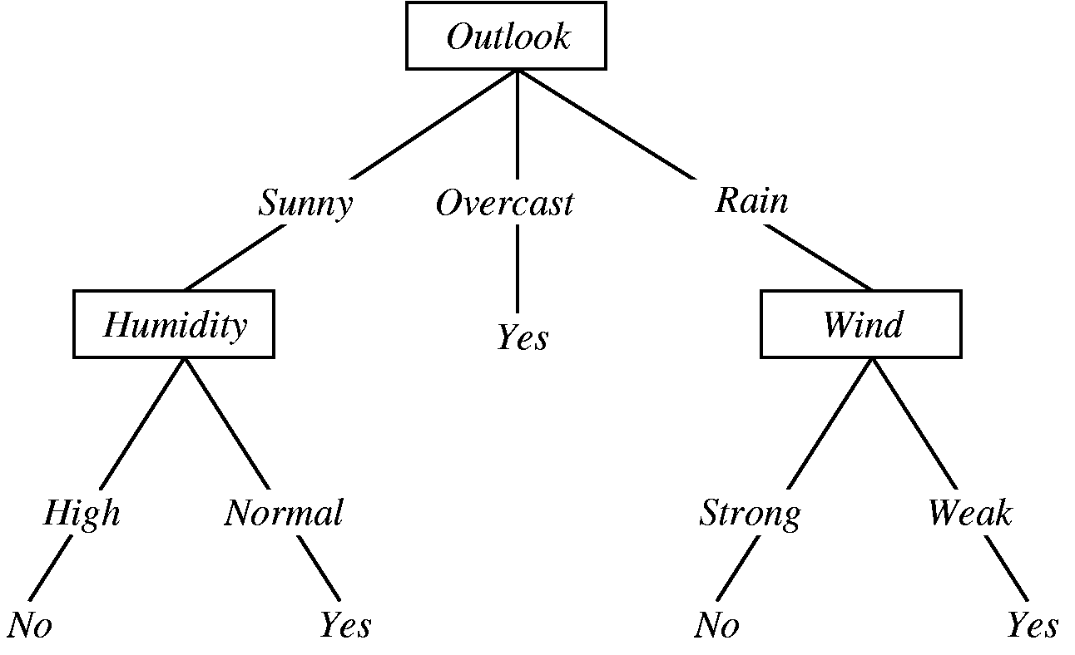
Rule Post Pruning

Slide 49
Rule Post Pruning
Split data into training and validation sets.
Do until further pruning is harmful:
  1. Evaluate impact on validation set of pruning each possible node (plus those below it)
  2. Greedily remove the one that most improves validation set accuracy
Produces smallest version of most accurate subtree.
Requires that a lot of data be available.

Slide 50
Rule Post Pruning
Infer tree as well as possible.
Convert tree to equivalent set of rules.
Prune each rule by removing any preconditions that result in
improving its estimated accuracy.
Sort final rules by their estimated accuracy and consider them in
this sequence when classifying.
The tree on the left becomes the set of rules:
IF (Outlook=Sunny) AND (Humidity=High)
THEN PlayTennis=No
IF (Outlook=Sunny) AND (Humidity=Normal)
THEN PlayTennis=Yes
IF (Outlook=Overcast)
THEN PlayTennis=No ...and so on

Slide 51
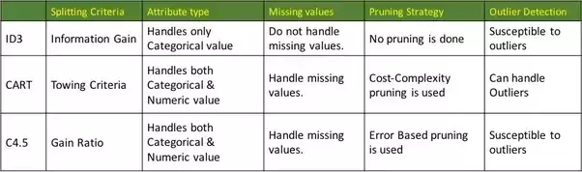
Comparison of ID3,
C4.5 and CART

Slide 52
References
"Machine Learning", by Tom Mitchell, McGraw-Hill, 1997
"Building Decision Trees with the ID3 Algorithm", by: Andrew Colin, Dr. Dobbs Journal, June 1996
http://www2.cs.uregina.ca/~dbd/cs831/notes/ml/dtrees/dt_prob1.html
Professor Sin-Min Lee, SJSU. http://cs.sjsu.edu/~lee/cs157b/cs157b.html

